Slide 1

TX08 Firmware
Why a slow 8051 can make us measurement

Slide 2


Hvem er jeg?
Navn: Gert Lauritsen
Bedrifter:
  Svagstrømsingeniør
  Medskifter af Skytem
  SW&HW udvikler
Hobby og Fritid:
  Vinterbader
  3 børn, kone, hus og Elbil

Slide 3

System Context
Module responsibilities
Programable counter array
Sampling
Communication

Slide 4
Module Responsibilities
TxProc.c
Pulse sequencing
PCA compare setup
State machine
AnalogSample.c
ADC configuration
Sample readout
Scaling
Komunikation.c
UART protocol
Command parsing
Data reporting
config.c
Parameter validation
Default values
RAM configuration
F000_FlashPrimitives.c
Low-level flash access
Parameter persistence
Global.c
Shared state
Flags and counters

Slide 5
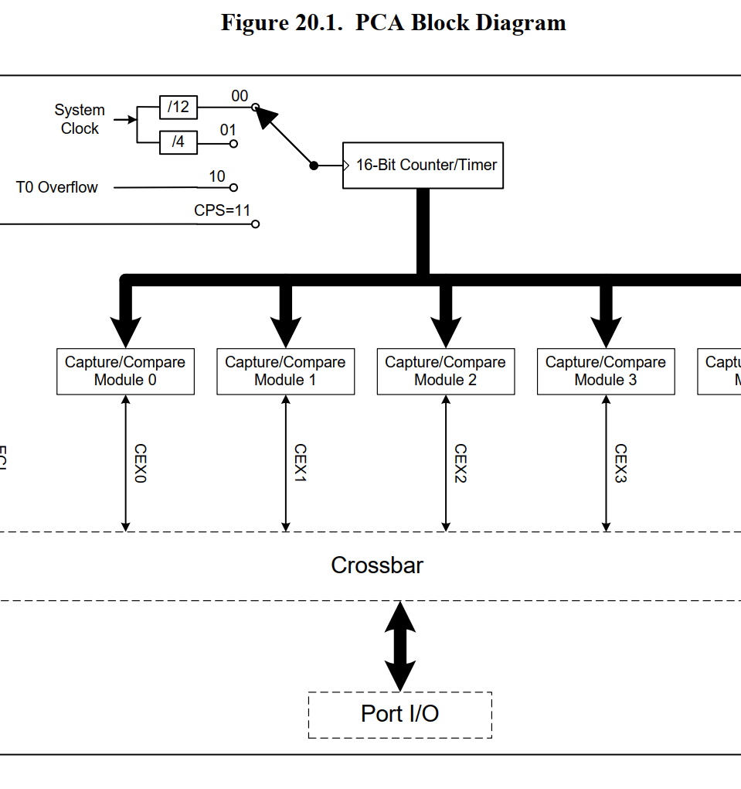
void PCA0_ISR (void) interrupt
The PCA0 ISR is the heartbeat of the transmitter:
Triggers ADC conversions
Advances the ADC multiplexer state machine
Associates samples with TX state (ON / OFF / CLAMP)
All timing is deterministic and hardware-driven.

Slide 6
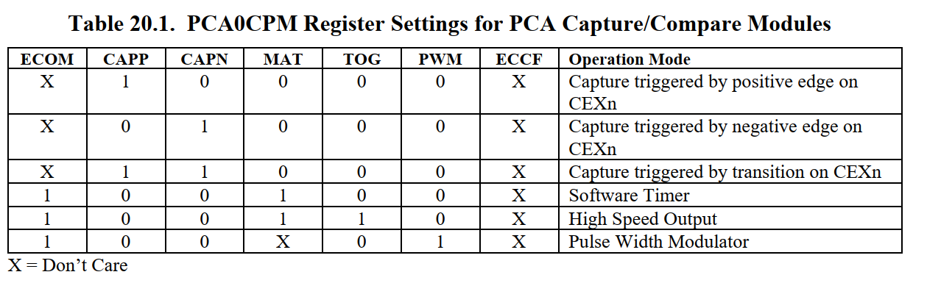
PROGRAMMABLE COUNTER ARRAY

Slide 7
PROGRAMMABLE COUNTER ARRAY
PCA interrupt is acting as the real-time executive for:
Detecting transmitter switching edges (capture on module 0)
Scheduling precisely-timed ADC measurements during on-time and off-time
Sequencing a sign/polarity pattern (signtable) at each cycle
Running an auxiliary self-test toggling via module 3

Slide 8
Module-by-module walkthrough of ISR
Timestamping first pulse of a data sequence
Schedule an on-time measurement using Timer3
  Increment counters and allow measurement
  Compute on-time using last ON capture
  Series/pulse counting for “moment” completion
  Schedule an off-time measurement using PCA module 1 as a one-shot compare

Slide 9
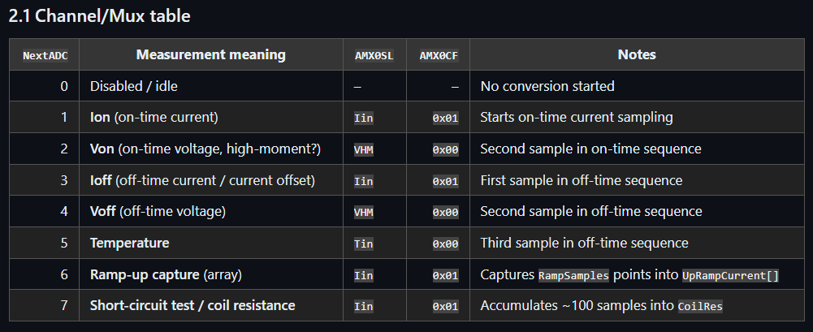
Sampling
On-time measurement sequence (NextADC = 1)
Triggered once by Timer3_ISR, then chained by the ADC ISR:
NextADC = 1 → measure Ion
  Applies IOffset compensation
  Accumulates into:
    cstak.current
    cstak.varcurrent (sum of squares)
    cstak.maxcurrent, cstak.mincurrent
    cstak.NPeriode++
  Sets NextADC++ → becomes 2
NextADC = 2 → measure Von
  Accumulates cstak.von += tmpint
  Sets NextADC = 0 (sequence ends)

Slide 10
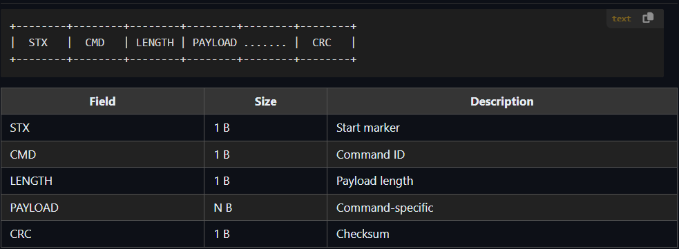
Communication Interface
Supported Commands
Read status
Set TX parameters
Start / stop TX
Request sampled data
Flash read/write

Slide 11
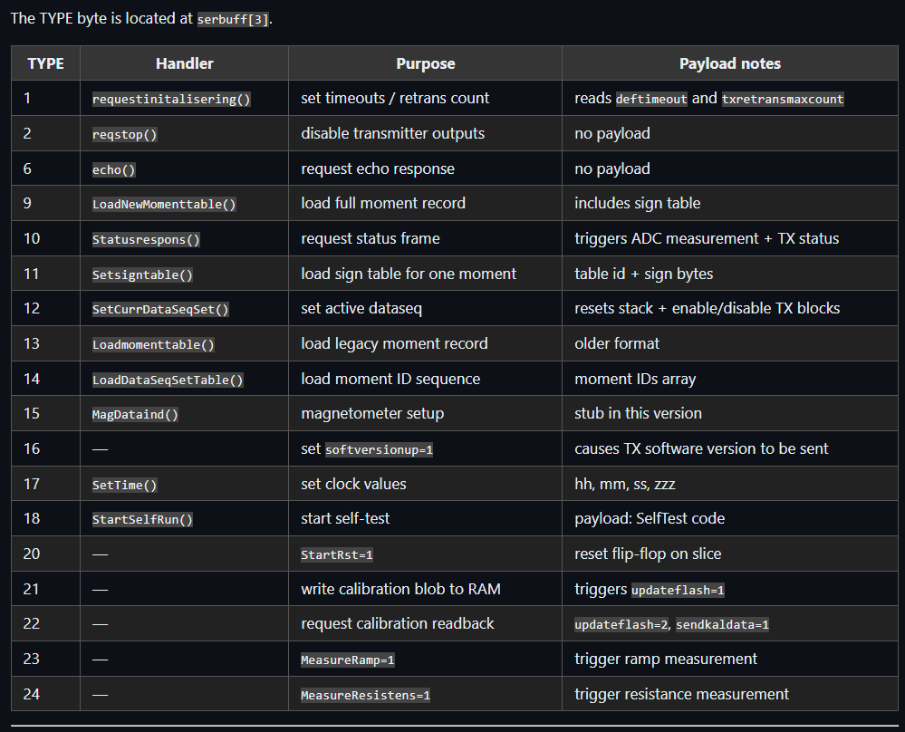
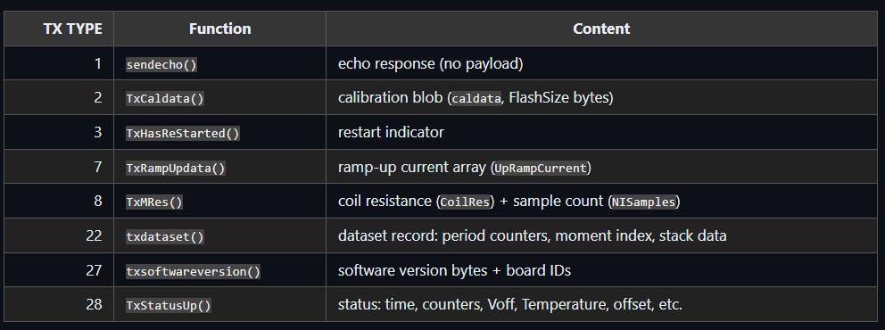
Communication Interface

Slide 12
Setup dev system
Uses Keil PK-51 compiler in a silabs IDE
https://www.silabs.com/software-and-tools/8-bit-8051-microcontroller-software-studio?tab=downloads

